Slide 1
SEE MY MIND
Technical Blueprint
High-level design for mobile-first, secure, workflow-driven SEND communication and evidence platform
v0.2 - expanded architecture, data, privacy, workflow and mobile design
15 September 2026

Slide 2
ORIENTATION
Purpose of this blueprint
A shared technical reference for founders, volunteers, school demos, UCL RAG discussion and pre-seed planning
Define the target conceptual architecture before workstreams diverge.
Document the layers: user experience, workflow, Frappe application, data, security, reporting, AI and integration.
Separate what is required for an October demonstration from what is required for a live pilot with real data.
Give volunteers and reviewers a consistent boundary: where to build, where to challenge and where not to duplicate effort.
Design principle: the prototype should remain production-shaped. We can simplify screens and workflows for the demo, but not ignore privacy, role boundaries, audit or the future mobile usage model.
Current status: POC has started the core model in Frappe: School, Child, Guardian, Staff, relationships, Child Event timeline and Observation foundation.
Decision needed: approve this blueprint as the working baseline, then refine through code review, security review, and school/user feedback.
See My Mind Technical Blueprint v0.2
Confidential working design

Slide 3
ORIENTATION
Contents
The deck moves from concept to architecture, security, delivery and decisions
1. Executive view
2. Target conceptual architecture
3. User profiles and UX principles
4. Technology stack and channels
5. Frappe application layer
6. Workflow and rules layer
7. Data model and foundation data
8. Privacy and data governance
9. Multi-tenancy model
10. Entitlement and security
11. Reporting and dashboards
12. AI / RAG layer
13. Mobile app model
14. Import/export and interoperability
15. Environments and operations
16. Assurance and release gates
17. MVP build roadmap
18. Open decisions and next steps
See My Mind Technical Blueprint v0.2
Confidential working design

Slide 4
EXECUTIVE SUMMARY
Executive summary
Recommended architecture and delivery posture
Architecture
Mobile-first custom UI over Frappe. Frappe owns data model, workflow, permissions, audit and backend services.
Database
MariaDB for initial Frappe implementation. PostgreSQL not selected for MVP due to maturity/support considerations.
Security
School/tenant isolation, RBAC, record permissions, 2FA, audit, consent and controlled exports must be baseline features.
AI/RAG
Advisory layer only. Facts, observations and AI inference must remain separate with provenance.
Delivery
Build demo vertical slice first; move to controlled pilot only after security and privacy gates pass.
See My Mind Technical Blueprint v0.2
Confidential working design

Slide 5
01
01. Conceptual Architecture
The layers that make See My Mind coherent, secure and scalable
SEE MY MIND

Slide 6
ARCHITECTURE
Conceptual design - layered view
The application should be mobile-first at the edge, controlled by workflow and data governance at the core
User Experience Layer: iOS app, Android app, mobile web, desktop browser, role-specific journeys
Channel/API Layer: Authenticated endpoints, REST APIs, mobile wrapper/API gateway, push/email/SMS connectors
Workflow & Rules Layer: Child events, observations, incidents, handovers, alerts, review triggers, scheduled jobs
Application Layer: Frappe app: DocTypes, controllers, permissions, hooks, reports, background workers
Data Layer: MariaDB operational data, files/documents, audit logs, export packs, analytics snapshots
AI/RAG Layer: Vector index, source documents, AI runs, human-reviewed insights, evidence links
Critical pattern: the polished See My Mind UI is not the database. The UI is a role-specific presentation layer over a governed workflow/data platform.
See My Mind Technical Blueprint v0.2
Confidential working design

Slide 7
ARCHITECTURE
Target system map
A single Frappe product core surfaced through multiple secure channels
iOS App
Mobile-first user experience
MariaDB
Operational data per site/tenant
See My Mind UI
Custom frontend, role journeys, simplified screens
Frappe Backend
DocTypes, roles, workflows, APIs, jobs, audit
Android App
Mobile-first user experience
Files & Evidence
Documents, exports, evidence packs
Browser App
Responsive web for school/admin
AI/RAG Service
Advisory insights and evidence retrieval
Important: mobile apps should not bypass Frappe permissions. They should call the same application APIs as the browser experience, with device-specific features such as push notifications and secure storage added at the mobile shell layer.
See My Mind Technical Blueprint v0.2
Confidential working design

Slide 8
ARCHITECTURE
User channel strategy
Mobile is principal usage; browser remains essential for school and administration workflows
Parent / Guardian mobile
Daily handovers, messages, child summaries, support tips, consent and exports.
Teacher / TA mobile
Quick observations, arrival/transition notes, alerts, strategy outcomes.
SENCO / school browser
Registers, reviews, EHCP evidence packs, reporting, user/admin controls.
Child view
Simple check-ins, toolkit, strengths and self-reporting with age-appropriate controls.
Recommendation: start with responsive web + PWA-style mobile use for the prototype, then package the mobile experience through Capacitor or a native shell for App Store / Google Play once flows stabilise.
Do not build two separate native apps at the outset unless push notifications, offline capture, biometrics or app-store credibility justify the added cost.
See My Mind Technical Blueprint v0.2
Confidential working design

Slide 9
USER EXPERIENCE
Target UX principles
The final interface should feel like See My Mind, not like a generic database front end
Simple first action
Parent/teacher can record the day in under a minute.
Role-specific screens
Show only what the role needs: parent, child, teacher, TA, SENCO, admin.
One child timeline
Events, handovers, observations and incidents appear as a coherent story.
Low typing burden
Use taps, quick choices, structured prompts and optional notes.
Trust and transparency
Show who reported what, when, and whether it is fact, observation or inference.
Accessible by design
Large touch targets, plain language, mobile layouts and low cognitive load.
The Frappe Desk should remain an admin/development interface. The real product UI should be a custom See My Mind interface over the Frappe backend.
See My Mind Technical Blueprint v0.2
Confidential working design

Slide 10
USER EXPERIENCE
User profiles and experiences
Each profile needs a deliberately scoped journey, not a shared generic form
Parent / Guardian
Morning handover, home observations, messages, daily summary, consent, exports.
Child
Self check-in, toolkit, strengths, simplified learning/support prompts.
Teacher
Class dashboard, quick observation, timeline, strategies, parent visibility.
Teaching Assistant
Assigned pupils, immediate actions, quick log, transition support.
SENCO / SEND Lead
Register, reviews, evidence, interventions, reports, restricted cases.
School Admin / Head
Users, roles, school data, reporting, governance and audit.
Specialist / External Professional
Bounded read/write access where consent and school policy allow.
See My Mind Admin
Tenant provisioning, product support, configuration, release governance.
See My Mind Technical Blueprint v0.2
Confidential working design

Slide 11
02
02. Platform and Application Layers
Frappe as the controlled product core, not merely an admin tool
SEE MY MIND

Slide 12
TECHNOLOGY
Recommended technology stack
Confirmed working POC stack and target production posture
Frontend
Custom See My Mind UI, responsive web, mobile-first layout, later Capacitor/native wrapper
Application framework
Frappe Framework v16 app with DocTypes, controllers, roles, hooks, background jobs and reports
Database
MariaDB as primary Frappe operational database for MVP and production baseline
Workflow
Frappe workflows, controller hooks, notifications, scheduled jobs and rule evaluation
Integration
Frappe REST APIs, whitelisted methods, file import/export, future school/MIS connectors
AI/RAG
Separate AI service/vector index with Frappe-held provenance and human review records
Hosting
DEV local Docker, UAT hosted site, production managed hosting with HTTPS, backups and monitoring
Source assumptions: Frappe Framework docs on Apps, Sites, REST API, Reports, Permissions, Two Factor Authentication and Multi-tenancy. MariaDB is the recommended initial database for this Frappe implementation.
See My Mind Technical Blueprint v0.2
Confidential working design

Slide 13
TECHNOLOGY
Frappe application layer
What Frappe should own inside See My Mind
DocTypes and schema
School, Child, Guardian, Staff, Event, Observation, Incident, Support Profile, EHCP and AI provenance objects.
Controllers and hooks
Server-side business rules: populate display names, snapshot school, create linked timeline records, validate assignments.
Permissions and roles
Role permissions, user permissions, record-level constraints, export controls and admin segmentation.
Workflow and background jobs
Status transitions, notifications, scheduled checks, escalation rules and review creation.
Reports and dashboards
Operational lists, saved reports, script reports, evidence packs and summary dashboards.
API surface
Whitelisted methods for mobile/browser UI; DocType REST API only where appropriately controlled.
See My Mind Technical Blueprint v0.2
Confidential working design

Slide 14
TECHNOLOGY
Database and storage model
MariaDB is the recommended operational database for the Frappe-based MVP
MariaDB
Frappe operational database
DocTypes become tab* tables
File Storage
Attachments, documents, evidence packs, generated exports
Analytics Store
Optional snapshots/materialised reporting layer as scale grows
Why MariaDB now: the current local Frappe v16 development stack uses MariaDB 11.8, Frappe production usage is strongly established on MariaDB, and this reduces platform risk for an October-oriented MVP.
PostgreSQL can be revisited later only if Frappe support and project requirements justify it. The current design should not add database migration risk before the product and security model have stabilised.
See My Mind Technical Blueprint v0.2
Confidential working design

Slide 15
TECHNOLOGY
Environment model
Separate development, UAT and production from the start
DEV
Developer test data only
Local Docker / Frappe bench
Fast iteration and schema work
UAT
Synthetic school data
School/user acceptance testing
Security fixes verified here
PROD
Real data only after gates pass
2FA, HTTPS, backups, monitoring
Strict change control
No real child/SEND data should enter DEV. Production must only be reached after privacy, security, support and recovery gates have been met.
See My Mind Technical Blueprint v0.2
Confidential working design

Slide 16
03
03. Data Model and Foundation Data
The schema beneath the product experience and workflow engine
SEE MY MIND

Slide 17
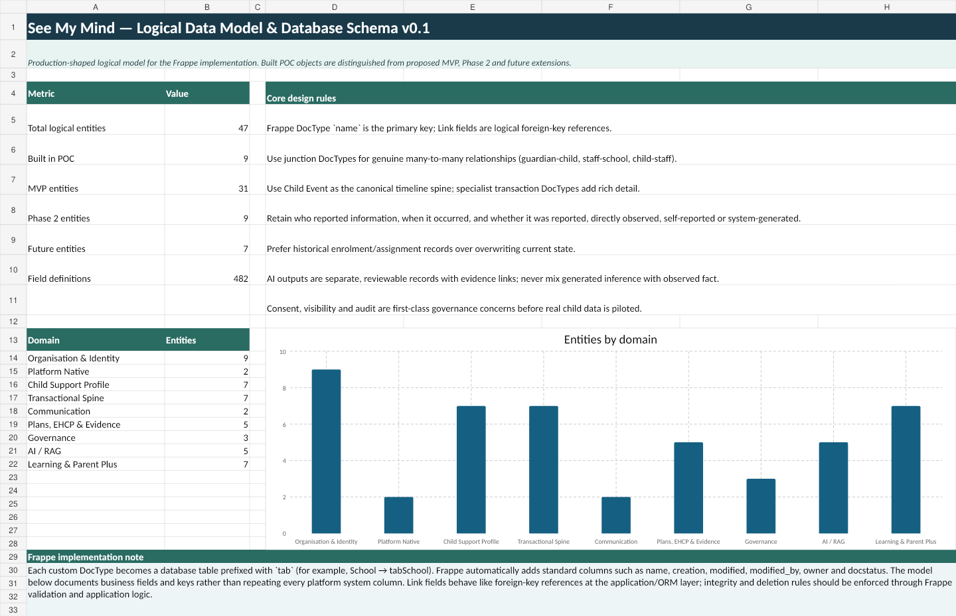
DATA MODEL
Logical data model - overview
The model separates foundation data, transactional timeline, support/EHCP records, governance and AI provenance
The detailed data model exists as a companion schema workbook with entity definitions, fields, PK/FK references, cardinality, classifications and build phases.
See My Mind Technical Blueprint v0.2
Confidential working design

Slide 18
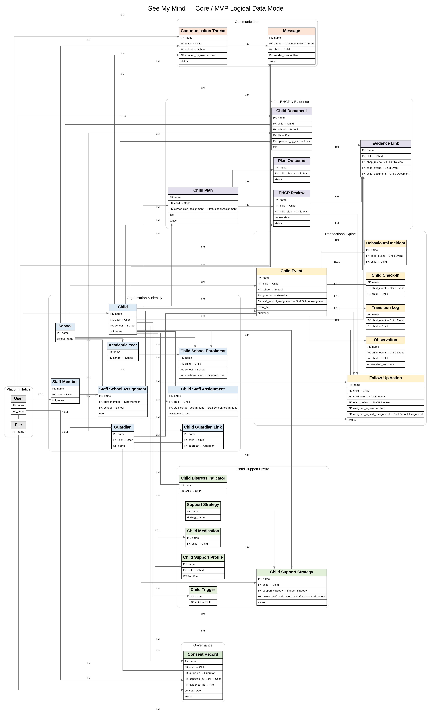
DATA MODEL
Core / MVP data model
Master data and transactional records needed for the first real product slice
See My Mind Technical Blueprint v0.2
Confidential working design

Slide 19
DATA MODEL
Foundation data domains
Stable objects that transactions and workflows depend on
Organisation
School, site/tenant, school contact details, school settings.
Pupil
Child, current school, school enrolment history, year group, sex, date of birth.
Family
Guardian and Child Guardian Link: relationship, responsibility, primary contact, comms rights.
Staff
Staff Member, Staff School Assignment, Child Staff Assignment.
Support reference
Support needs, strategy catalogue, intervention types, context values, severity/significance values.
Governance reference
Roles, visibility rules, consent purposes, retention rules, export formats.
See My Mind Technical Blueprint v0.2
Confidential working design

Slide 20
DATA MODEL
Foundation data governance
Poor reference data will undermine security, workflow and reporting
Every child must have a current school context and a retained enrolment history.
Guardian access must be relationship-based, not simply person-based.
Staff access must flow through Staff School Assignment and Child Staff Assignment.
All sensitive dropdowns need controlled values, not free-text drift.
Data ownership must be explicit: school-owned, parent-supplied, child self-reported, system generated or AI generated.
Bulk import templates should validate identifiers, duplicates, mandatory fields and tenant boundaries before load.
Governance rule: foundation data changes should be auditable and controlled. Changing a school, guardian, staff assignment or communication entitlement can change who sees a child.
Recommended gate: no school pilot until seed data import, duplicate detection, permission checks and export format validation have been tested end-to-end.
See My Mind Technical Blueprint v0.2
Confidential working design

Slide 21
WORKFLOW AND DATA
Transactional spine - Child Event
One timeline holds the child story; specialist records hold the detail
Child Event
Child, time, context, summary, evidence basis, significance, visibility, status
Reporter
Parent, child, staff or system
Detail Record
Observation, handover, incident, strategy use, follow-up or communication
Why this matters: one coherent timeline can power the parent summary, teacher view, SENCO evidence pack and future analytics without flattening all transaction types into one oversized table.
See My Mind Technical Blueprint v0.2
Confidential working design

Slide 22
WORKFLOW AND DATA
Transactional object catalogue
Main transactional objects and how they relate to the timeline
Child Event
Canonical timeline wrapper; one row per reportable event.
Observation
Wellbeing, learning, communication, sensory, strategy and outcome detail.
Morning / End-of-Day Handover
Parent-school daily context, sleep, food, medication, mood and summary.
Child Check-In
Child self-report, mood, support request and immediate need.
Behavioural Incident
Antecedent, behaviour, response, severity, safeguarding and resolution.
Strategy Use / Outcome
Which strategy was used and whether it worked.
Follow-Up Action
Assigned action, owner, due date, status and closure evidence.
Communication
Messages that form part of the child record.
See My Mind Technical Blueprint v0.2
Confidential working design

Slide 23
04
04. Workflow, Reporting and AI
Moving from records to action, insight and evidence
SEE MY MIND

Slide 24
WORKFLOW
Workflow layer
Workflow sits above the data model and turns events into action
1. Capture
Parent, child, teacher, TA or system creates a record.
2. Classify
Event type, evidence basis, significance, visibility and context are set.
3. Evaluate rules
Trigger thresholds, missing handovers, repeated concerns, review dates.
4. Notify / assign
Create action, notify assigned staff, request SENCO review.
5. Evidence
Attach to timeline, reports and EHCP/evidence packs.
Workflow rules should be explicitly catalogued, tested and versioned. They are product logic, not ad-hoc notifications.
See My Mind Technical Blueprint v0.2
Confidential working design

Slide 25
WORKFLOW
Initial workflow catalogue
Start with practical workflows that prove value and safety
Daily handover
Morning handover submitted -> teacher dashboard -> end-of-day summary due.
Missing check-in
Expected morning handover absent by cut-off -> reminder to parent or school.
High concern
Concern/Urgent/Critical event -> assigned staff/SENCO notified -> action created.
Repeated pattern
N concerns in N days -> review-required flag and evidence pack draft.
Strategy outcome
Strategy used -> effectiveness captured -> support profile updated after review.
EHCP review
Review date approaching -> evidence collection tasks and report generation.
See My Mind Technical Blueprint v0.2
Confidential working design

Slide 26
REPORTING
Reporting and dashboard engine
Operational reporting must be permission-aware and exportable
Operational Dashboards
Today, my pupils, alerts, missing handovers, open actions
Evidence Reports
Child timeline, EHCP pack, strategy effectiveness, incident chronology
Analytical Views
Patterns by context, time, strategy, cohort and school
Reporting should use Frappe report builder/query/script reports for admin and school reporting, then custom dashboards for the product UI.
Every report must inherit the same access model as the product screens: no report should become a back door around school, child, guardian or restricted visibility rules.
See My Mind Technical Blueprint v0.2
Confidential working design

Slide 27
REPORTING
Dashboard catalogue
Dashboards should be role-specific and not overloaded
Parent
Today at a glance, school summary, support tips, messages, exports.
Teacher
My pupils, today’s alerts, quick observation, strategies, missing handovers.
TA
Assigned pupils, high-risk moments, quick log, immediate actions.
SENCO
SEND register, emerging needs, reviews, evidence packs, EHCP deadlines, patterns.
School leadership
Cohort health, workload, compliance, incident trends, adoption.
See My Mind admin
Tenant status, support queue, uptime, usage, failed jobs, audit exceptions.
See My Mind Technical Blueprint v0.2
Confidential working design

Slide 28
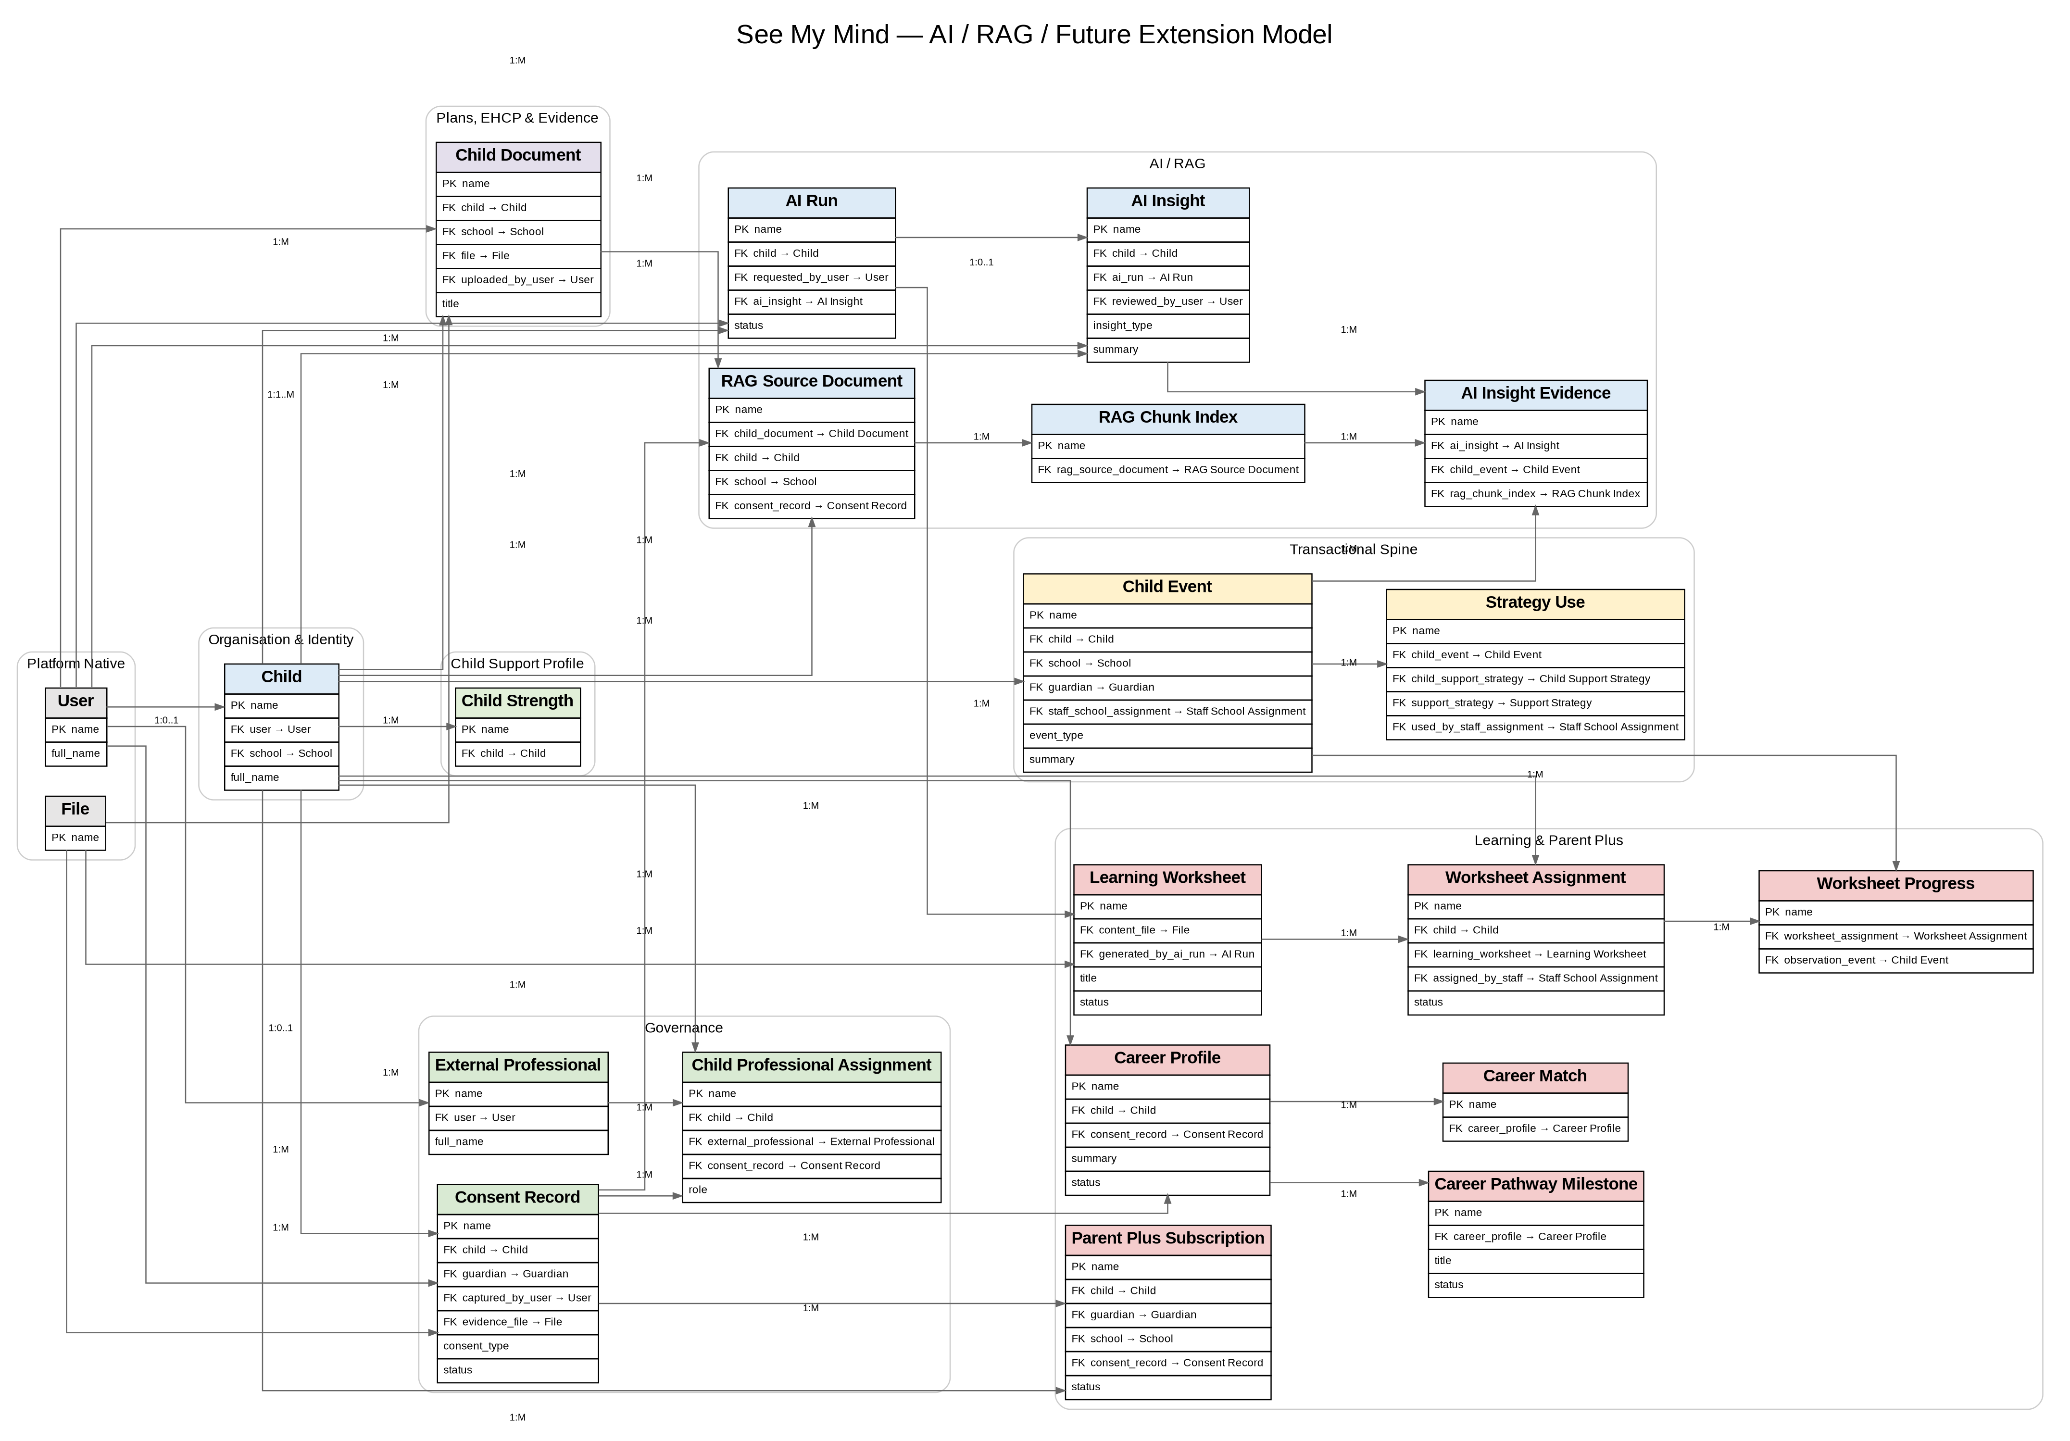
AI AND RAG
AI / RAG conceptual architecture
AI should support interpretation and drafting, not become the unreviewed system of record
AI outputs must be stored as AI Insight records with source evidence, model/run metadata, confidence/risk flag and human review status.
See My Mind Technical Blueprint v0.2
Confidential working design

Slide 29
AI AND RAG
AI safety and provenance guardrails
Separate facts, observations and inference
No silent diagnosis
AI must not diagnose, label or make safeguarding decisions autonomously.
Evidence linked
Every insight should cite the events/documents that informed it.
Human review
AI-generated summaries and patterns need review before external sharing.
Data minimisation
Send only the data needed for the specific AI task.
Model/run logging
Store prompt class, model, timestamp, sources and output status.
Opt-in advanced use
Parent Plus / careers or research reuse needs separate purpose and consent.
See My Mind Technical Blueprint v0.2
Confidential working design

Slide 30
05
05. Privacy, Tenancy and Security
The platform has to be safe before it is clever
SEE MY MIND

Slide 31
PRIVACY AND SECURITY
Privacy model
Privacy is a first-class architecture layer, not a policy PDF added later
Classify every field: basic personal data, special category/SEND data, safeguarding, contact data, system metadata, AI inference.
Attach purpose and lawful basis to data capture and reuse: support, safeguarding, communication, reporting, product analytics, Parent Plus, research.
Capture provenance: who reported it, who observed it, who generated it, who reviewed it.
Minimise by role: parents, staff, SENCOs and external professionals do not need identical visibility.
Consent and communication entitlement must be modelled per child/guardian relationship, not globally per person.
Retention, deletion, archive and export must be designed before real data enters production.
See My Mind Technical Blueprint v0.2
Confidential working design

Slide 32
PRIVACY AND SECURITY
Data classification and handling
Classifying data controls visibility, export, audit and AI use
Public/low
School name, generic contact channels.
Normal access controls
Personal
Child name, DOB, guardian/staff contact details.
Access by relationship and role
Sensitive SEND
Diagnosis, support needs, EHCP, observations, medication context.
Need-to-know, audit, explicit visibility
Safeguarding/high risk
Critical incidents, restricted notes, professional concerns.
Restricted roles, enhanced audit, export control
AI generated
Patterns, summaries, recommendations, confidence.
Human review and evidence links
See My Mind Technical Blueprint v0.2
Confidential working design

Slide 33
PRIVACY AND SECURITY
Multi-tenancy model
School isolation should be explicit and testable
Option A
Site/database per school
Strongest isolation; cleaner breach boundary; more operational management
Option B
Shared database with school_id
Lower operational overhead; higher permission and query risk
Recommendation
Prototype with site-per-school assumption where possible; central reporting only through controlled export/aggregation
The architecture should support: school data isolation, separate user sets, per-school configuration, tenant-specific backups, controlled support access, and safe anonymised/aggregated reporting later.
See My Mind Technical Blueprint v0.2
Confidential working design

Slide 34
PRIVACY AND SECURITY
Entitlement and access model
Who can see a record must be derived from role + relationship + visibility + data classification
Role
Parent, child, teacher, TA, SENCO, admin, specialist, support.
Relationship
Guardian link, staff assignment, child assignment, school membership.
Record visibility
School staff only, guardian and school, child/guardian/school, restricted.
Data classification
Normal, sensitive SEND, safeguarding, AI, export-restricted.
Action permission
Read, create, edit, submit, review, export, delete, administer.
Entitlement must be tested negatively: unassigned staff cannot access child, guardian cannot access non-linked child, School A cannot see School B, restricted notes stay restricted, exports respect visibility.
See My Mind Technical Blueprint v0.2
Confidential working design

Slide 35
PRIVACY AND SECURITY
Authentication and 2FA
Two-factor authentication is mandatory for production users with access to sensitive data
Identity
Frappe user accounts for POC; later evaluate school SSO/OAuth/SAML where required.
2FA baseline
Mandatory OTP app/email/SMS policy for staff/admin; consider guardian 2FA depending on usability and risk.
Session security
Secure cookies, HTTPS only, timeout, device/session review, account lockout and rate limiting.
Admin controls
Separate System Manager, See My Mind Admin and School Admin roles. No shared accounts.
On/offboarding
Joiner/leaver process for school staff and immediate revocation on assignment end.
Recovery
Password reset flows must not expose child data or enable social engineering.
Frappe/ERPNext supports two-factor authentication options including OTP app, SMS and email; production policy and testing remain application responsibilities.
See My Mind Technical Blueprint v0.2
Confidential working design

Slide 36
PRIVACY AND SECURITY
Audit, monitoring and support access
Sensitive data systems need an audit trail that normal users cannot bypass
Audit every view, create, edit, submit, export, delete, permission change and support access to sensitive records.
Track who changed guardian entitlement, staff assignment, visibility and data classification.
Create exception reports for failed login bursts, unusual exports, cross-tenant errors and elevated permissions.
Log background jobs, notification delivery, AI runs, report generation and import/export outcomes.
Give support staff controlled break-glass access with reason, approval and audit.
Define incident response: triage, containment, notification, remediation and learning review.
See My Mind Technical Blueprint v0.2
Confidential working design

Slide 37
INTEGRATION
Import, export and interoperability
The platform must not trap schools or families inside See My Mind
Export formats
CSV/XLSX for structured data; PDF evidence packs; JSON for structured transfer.
Import routes
Foundation data import for schools, children, guardians, staff and assignments.
Child record export
Timeline, observations, incident history, support strategies, EHCP evidence and documents.
Migration readiness
Stable IDs, foreign key mapping, validation, duplicate detection and error handling.
External applications
Future MIS/SIMS/Arbor/SEN systems via controlled APIs or scheduled import/export.
Consent-aware exports
Exports must respect role, child, guardian relationship, visibility and restricted data rules.
See My Mind Technical Blueprint v0.2
Confidential working design

Slide 38
06
06. Mobile, Operations and Delivery
How the product gets from POC to demo to controlled pilot
SEE MY MIND

Slide 39
MOBILE
Mobile app architecture
Mobile is the principal user channel, but should not fragment the backend
Mobile Shell
Capacitor/native wrapper: push, secure storage, biometrics, app store packaging
Shared Frappe Core
Data model, workflow, permissions, audit, APIs
See My Mind UI
Mobile-first web frontend, reusable components
Recommended sequence: first prove the mobile-first browser/PWA flows; then wrap/package for Android and iOS once UX, permissions and workflow are stable.
Mobile-specific features to plan: push notifications, offline/draft capture, secure local storage, file/photo upload, biometrics, device loss policy and app-store release process.
See My Mind Technical Blueprint v0.2
Confidential working design

Slide 40
MOBILE
UI/API contract
The UI should call explicit application APIs, not directly manipulate unrestricted records
Dashboard API
Returns role-specific counts, alerts, assigned children and recent timeline events.
Child profile API
Returns child summary, guardians, staff, timeline and current open concerns.
Create observation API
Creates Child Event + Observation in one transaction.
Handover API
Creates morning/end-of-day handover and triggers notifications.
Export API
Generates permission-filtered child or school report packages.
AI insight API
Requests/retrieves advisory output with evidence links and review status.
See My Mind Technical Blueprint v0.2
Confidential working design

Slide 41
OPERATIONS
Operational model
A production system needs support, release and data operations as much as code
Support
Login issues, user setup, data corrections, school queries, incident triage.
Release management
DEV -> UAT -> PROD with release notes, rollback path and migration checks.
Backup / restore
Scheduled backups, restore tests, tenant-level recovery and evidence of success.
Monitoring
Uptime, errors, failed jobs, API failures, storage, queue depth, email/push delivery.
Security operations
Patch cadence, vulnerability scans, pen-test remediation, access review.
Data operations
Imports, exports, retention, deletion, archive, SAR support and consent changes.
See My Mind Technical Blueprint v0.2
Confidential working design

Slide 42
OPERATIONS
Go-live gates for real data
Real child/SEND data requires objective evidence, not confidence alone
Privacy
DPIA, lawful basis, consent model, retention/deletion, privacy notices.
Security
2FA, HTTPS, RBAC, record access tests, pen-test, vulnerability remediation.
Tenancy
Cross-school access tests, support access controls, backup isolation.
Data
Import templates, export packs, data dictionary, data quality checks.
Operations
Monitoring, backups, restore test, incident process, support model.
UAT
Parent, teacher, TA, SENCO and admin scenarios passed with synthetic data.
See My Mind Technical Blueprint v0.2
Confidential working design

Slide 43
DELIVERY
Recommended MVP build sequence
Build a thin but complete vertical slice before broadening the product
1. Foundation
School, child, guardian, staff, assignments, entitlement basics.
2. Timeline
Child Event backbone, observation detail, profile page.
3. Daily flow
Morning handover, teacher observation, end-of-day summary.
4. Workflow
Notifications, concerns, follow-up actions, SENCO review trigger.
5. Dashboards
Parent, teacher, TA, SENCO views using real data.
6. Assurance
UAT, privacy controls, pen test, export/import, backup/restore.
7. Mobile packaging
PWA first, then app-store packaging when flows are stable.
8. AI/RAG pilot
Advisory summaries and evidence retrieval after data controls mature.
See My Mind Technical Blueprint v0.2
Confidential working design

Slide 44
DELIVERY
Suggested workstreams
Give volunteers and reviewers bounded areas without creating competing architectures
Product / UX
Translate mock-up into role journeys, mobile screens, content patterns and UAT scripts.
Frappe Core
DocTypes, controllers, permissions, workflow, APIs and reports.
Data Model
Schema dictionary, field classifications, import/export templates and data governance.
Security / Privacy
DPIA, 2FA, RBAC tests, tenancy test pack, audit, pen-test coordination.
AI/RAG
RAG scope, source ingestion, prompt classes, AI evidence model and guardrails.
Demo / School readiness
Demo data, storyboards, clickable flows, scripted school demo scenarios.
See My Mind Technical Blueprint v0.2
Confidential working design

Slide 45
NEXT STEPS
Open architecture decisions
These need explicit decisions before a real pilot
Tenant model: site/database per school, shared database, or hybrid by customer scale.
Mobile approach: responsive web/PWA first, Capacitor wrapper, or native React Native/Flutter.
Identity: Frappe-native accounts first; when to support school SSO/OAuth/SAML.
AI provider and RAG architecture: vector store, model gateway, retention and data minimisation.
Data controller/processor model and school contract responsibilities.
Scope of October: demo, closed pilot with synthetic data, or limited real-data pilot after gates.
See My Mind Technical Blueprint v0.2
Confidential working design

Slide 46
NEXT STEPS
Recommended next deliverables
Convert the blueprint into executable product and assurance artefacts
HLD v0.3
Confirm architecture decisions and approved target stack.
Schema v0.2
Review data dictionary and settle MVP fields/enums.
Workflow catalogue
Define triggers, conditions, actions and notification rules.
Security model
RBAC matrix, tenancy tests, 2FA policy and audit requirements.
UX slice
Parent/teacher mobile flow: handover -> observation -> summary.
Demo pack
Scripted school demo using safe synthetic data.
See My Mind Technical Blueprint v0.2
Confidential working design

Slide 47
APPENDIX
Appendix - schema pack summary
A companion workbook carries the field-level schema
Foundation
School, Child, Child School Enrolment, Guardian, Staff Member, assignment/link tables.
Transactions
Child Event, Observation, Handover, Check-In, Incident, Strategy Use, Follow-Up Action, Communication.
Support / EHCP
Support Profile, Support Need, Strategy Catalogue, Intervention, EHCP Review, Evidence Item, Document.
Privacy / Governance
Consent, Access Grant, Data Export Request, Audit Event, Retention Policy, Data Classification.
Reporting / AI
Dashboard Config, Report Snapshot, AI Run, AI Insight, AI Evidence, RAG Source Document, RAG Chunk Index.
Use the workbook as the database schema control point. Changes to fields, cardinalities and classifications should be reviewed before implementation.
See My Mind Technical Blueprint v0.2
Confidential working design

Slide 48
APPENDIX
Reference assumptions
Current basis for the technical direction
Frappe is used as the application framework for DocTypes, permissions, workflow, APIs, reports and background jobs.
MariaDB is the recommended operational database for the initial Frappe implementation.
Frappe supports multi-site hosting; tenant strategy remains an explicit product decision.
Frappe supports role-based permissions, DocType-linked records, reports, REST APIs and two-factor authentication, but custom application security still requires independent testing.
Mobile apps should be built over the same permission-aware application API surface as the browser application.
No real child/SEND data should be introduced until privacy, security, tenancy, backup, support and UAT gates are met.
See My Mind Technical Blueprint v0.2
Confidential working design

